Slide 1
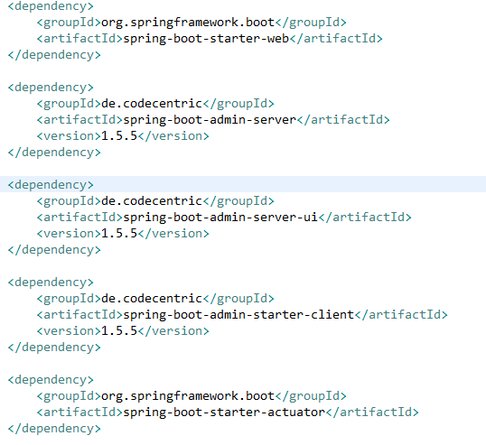

Spring Boot - Admin Client
For monitoring and managing your micro service application via Spring Boot Admin Server, you should add the Spring Boot Admin starter client dependency and point out the Admin Server URI into the application properties file.
Note − For monitoring an application, you should enable the Spring Boot Actuator Endpoints for your Micro service application.

Slide 2
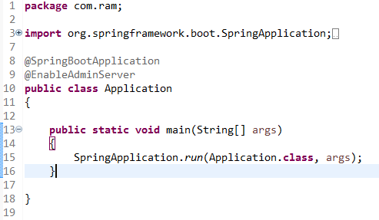
Spring Boot - Admin Client
Add the @EnableAdminServer annotation in your main Spring Boot application class file. The @EnableAdminServer annotation is used to make your as Admin Server to monitor all other microservices.

